Slide 1
Chapter 4
Time Response

Slide 2
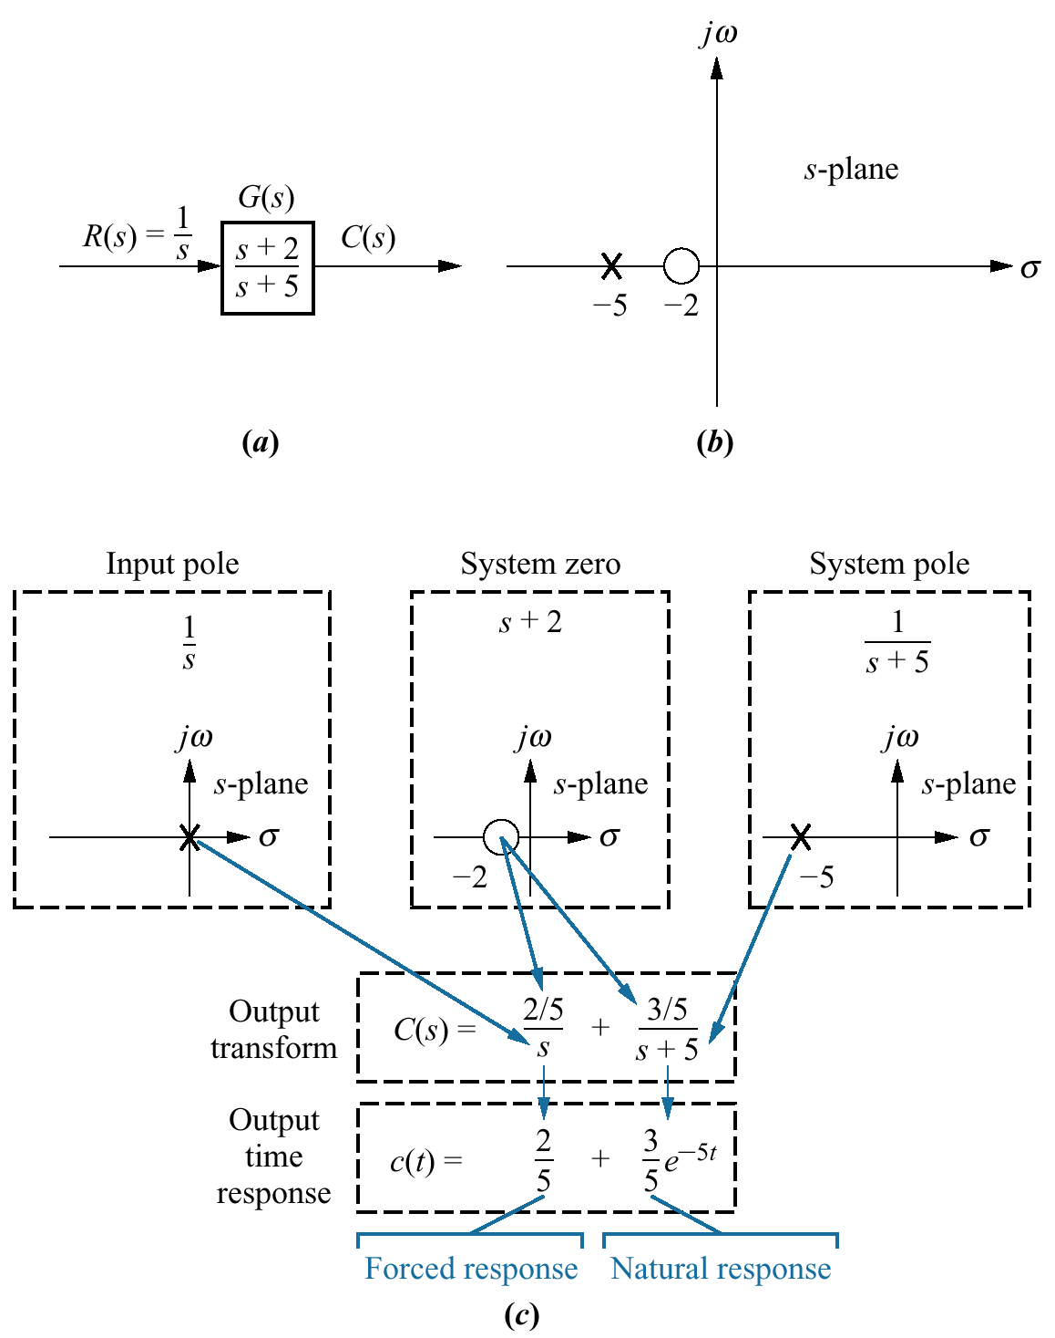
Figure 4.1
a. System showing
input and output;
b. pole-zero plot
of the system;
c. evolution of a
system response.
Follow blue arrows
to see the evolution
of the response
component generated
by the pole or zero.

Slide 3
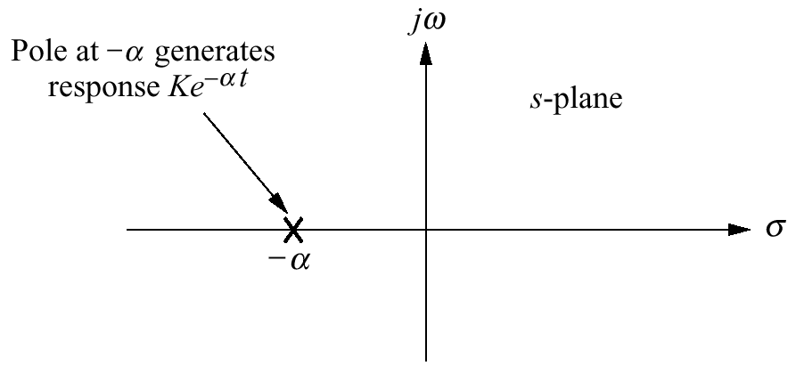
Figure 4.2
Effect of a real-axis
pole upon transient
response

Slide 4
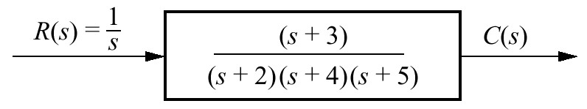
Figure 4.3
System for
Example 4.1

Slide 5
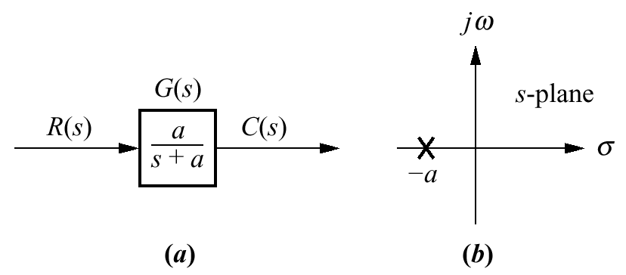
Figure 4.4
a. First-order system;
b. pole plot

Slide 6
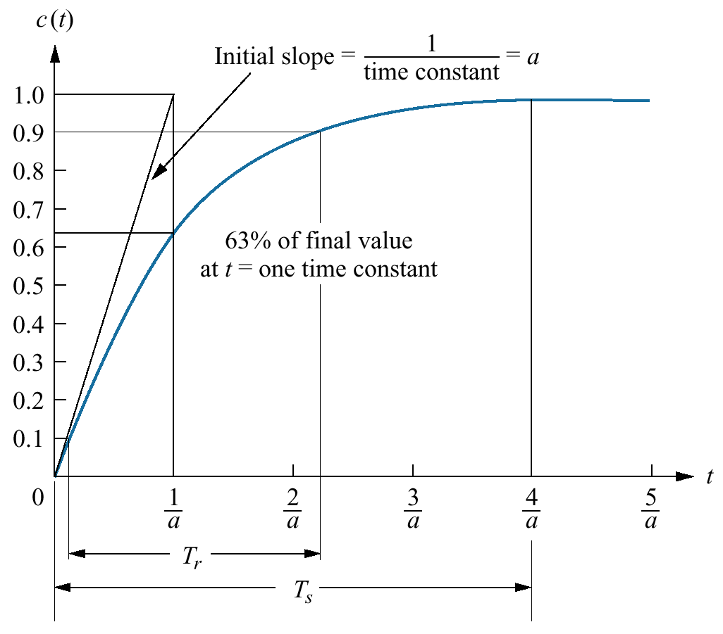
Figure 4.5
First-order system
response to a unit
step

Slide 7
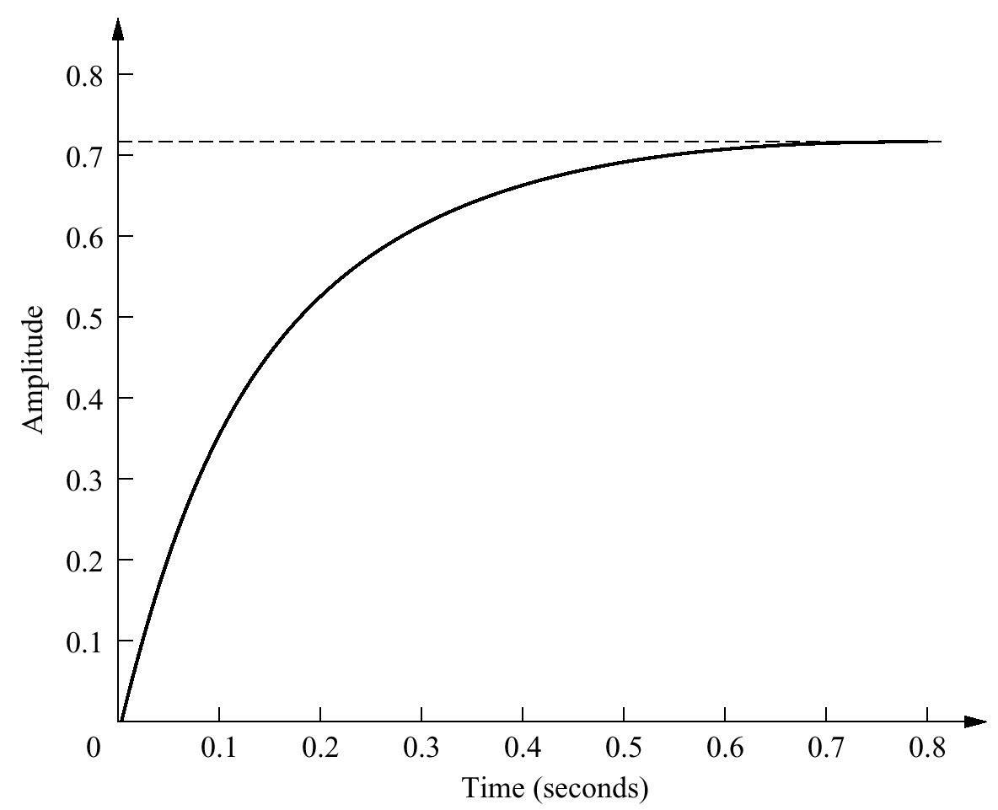
Figure 4.6
Laboratory results
of a system step
response test

Slide 8
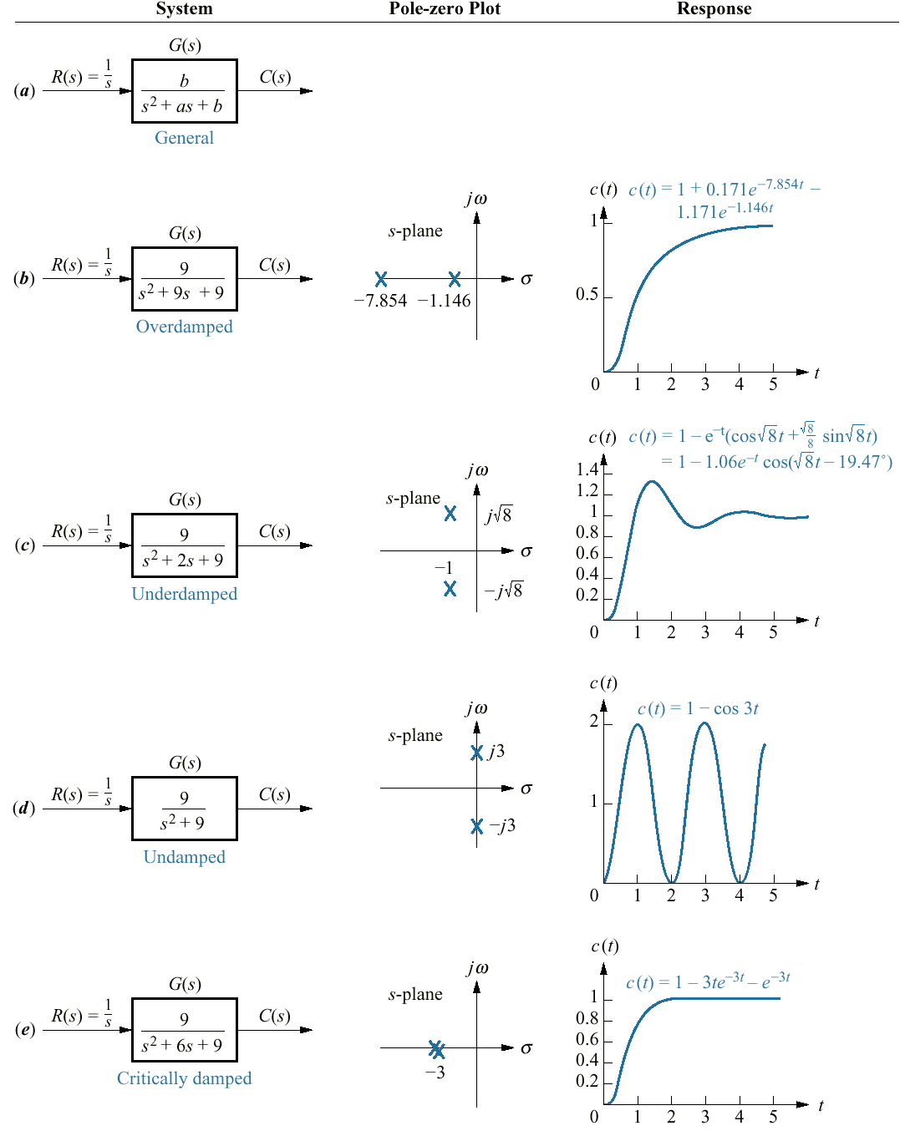
Figure 4.7
Second-order
systems, pole plots,
and step
responses

Slide 9
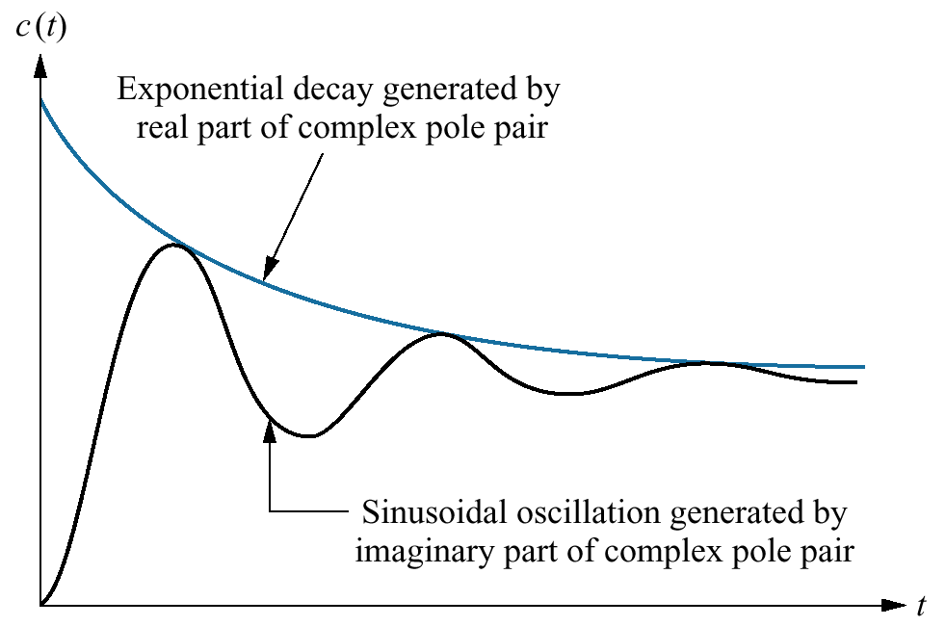
Figure 4.8
Second-order
step response
components
generated by
complex poles

Slide 10
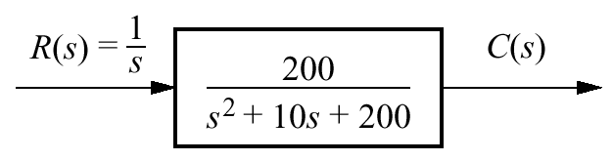
Figure 4.9
System for
Example 4.2

Slide 11
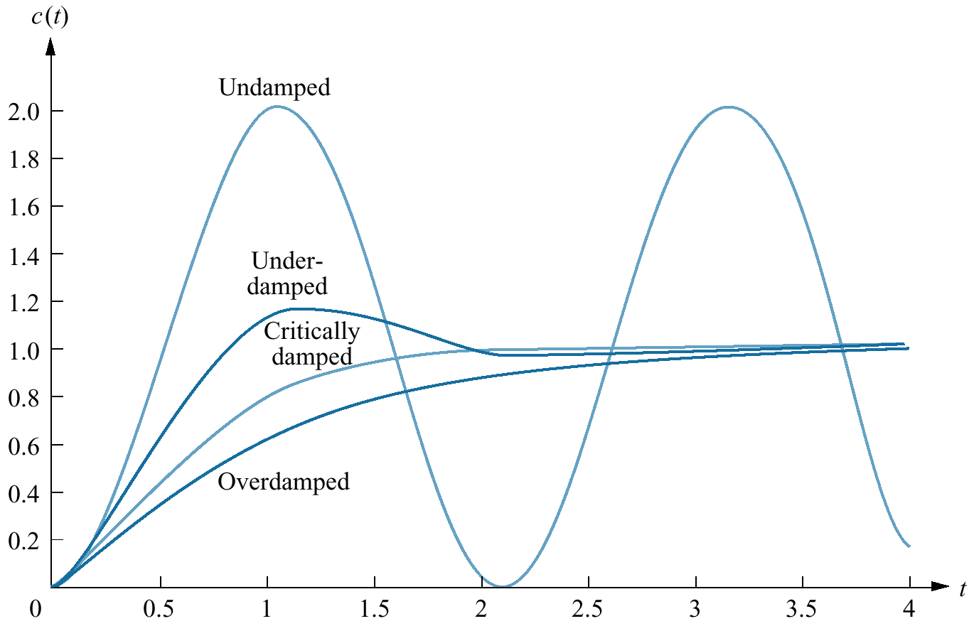
Figure 4.10
Step responses
for second-order
system
damping cases

Slide 12
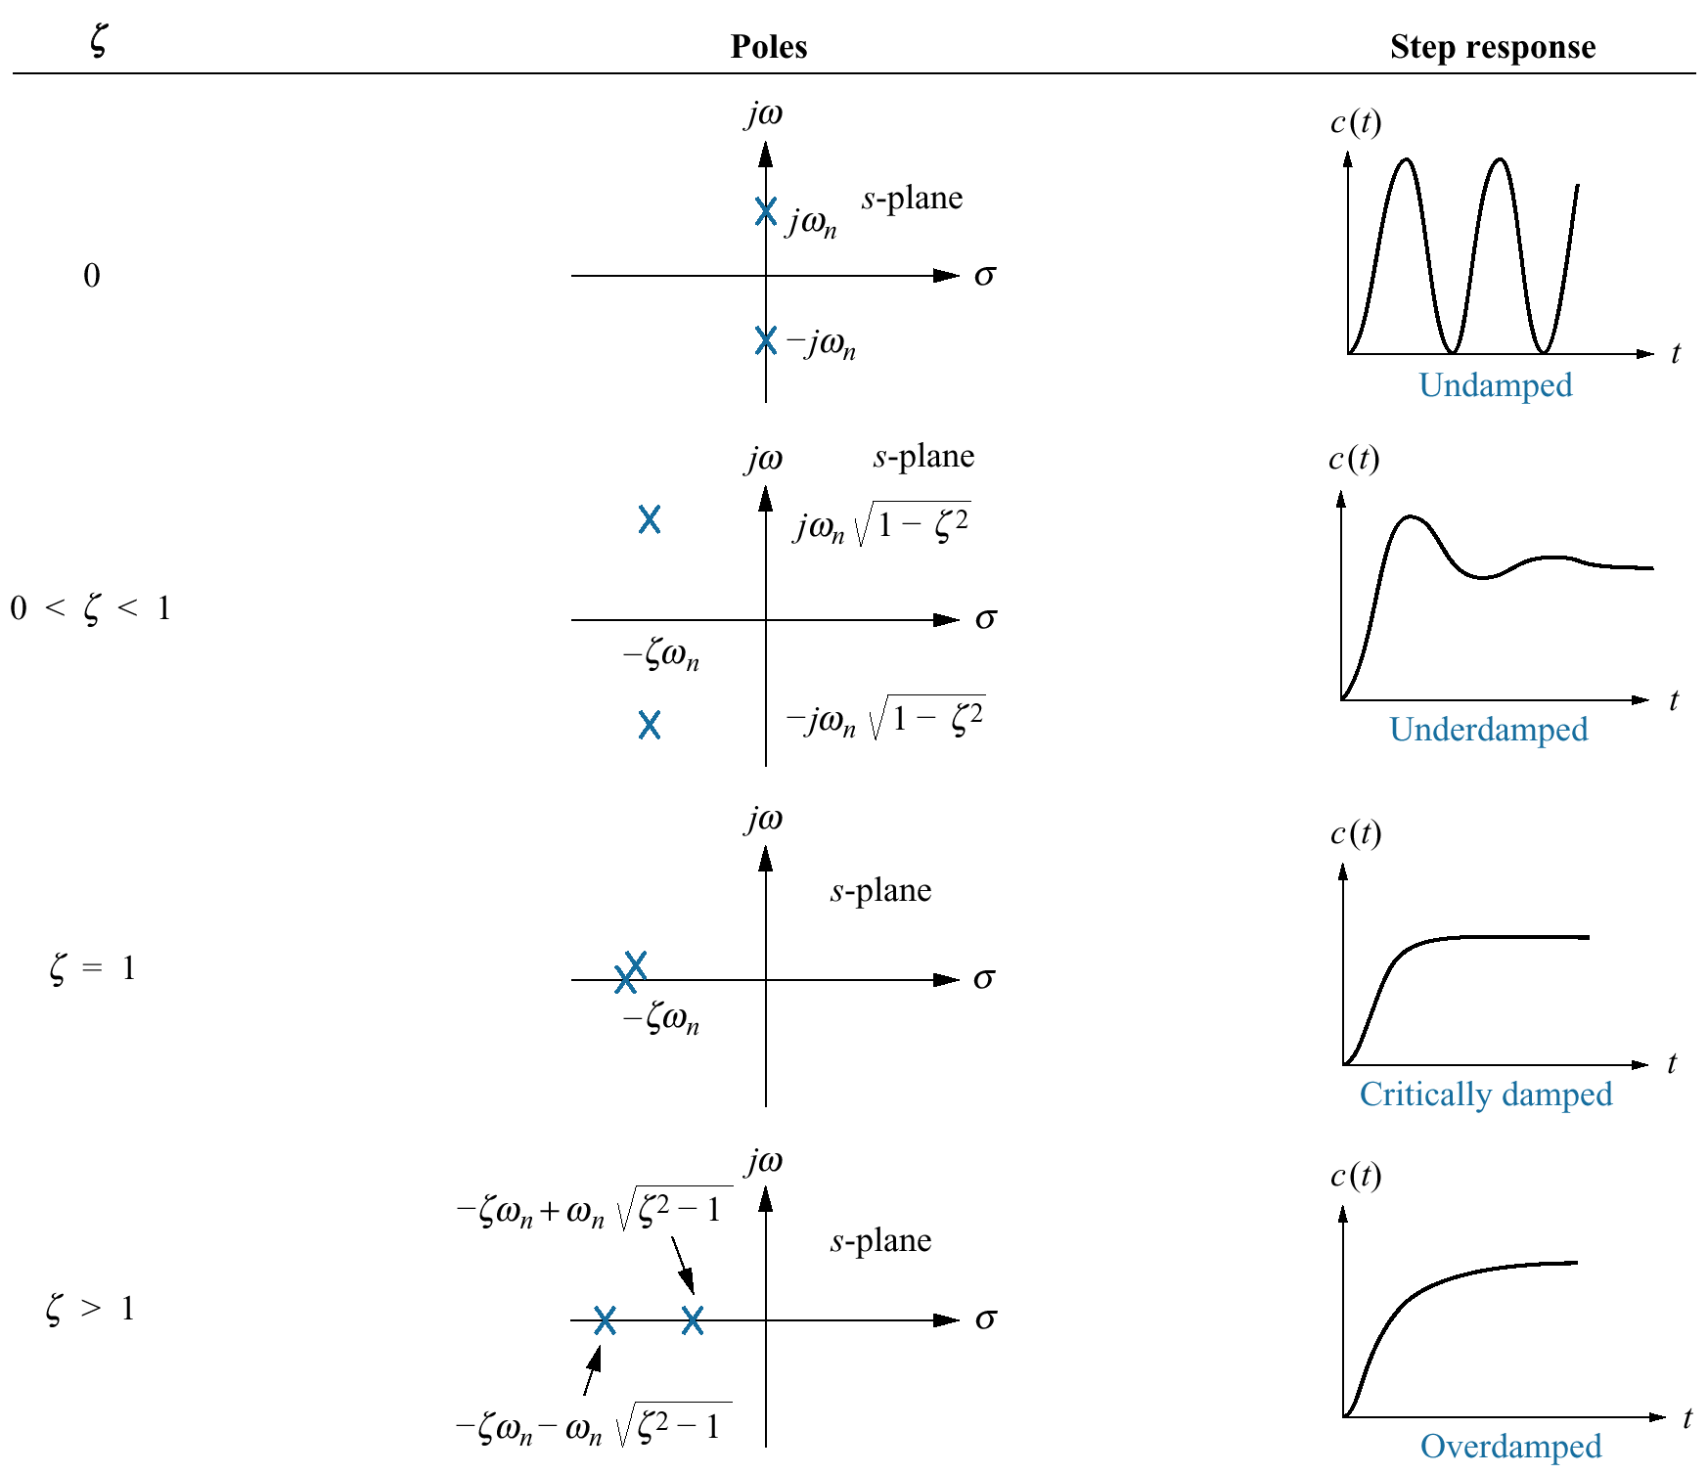
Figure 4.11
Second-order
response as a
function of
damping ratio

Slide 13
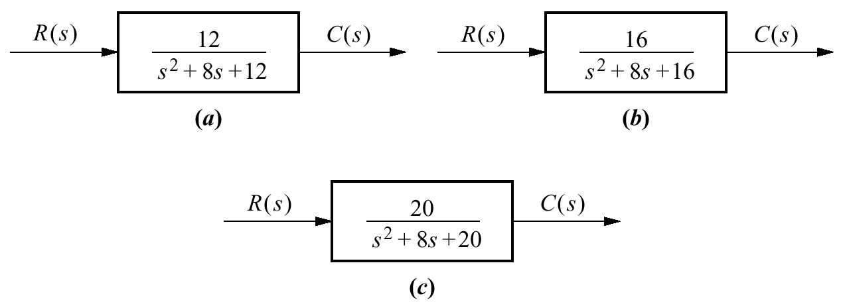
Figure 4.12
Systems for
Example 4.4

Slide 14
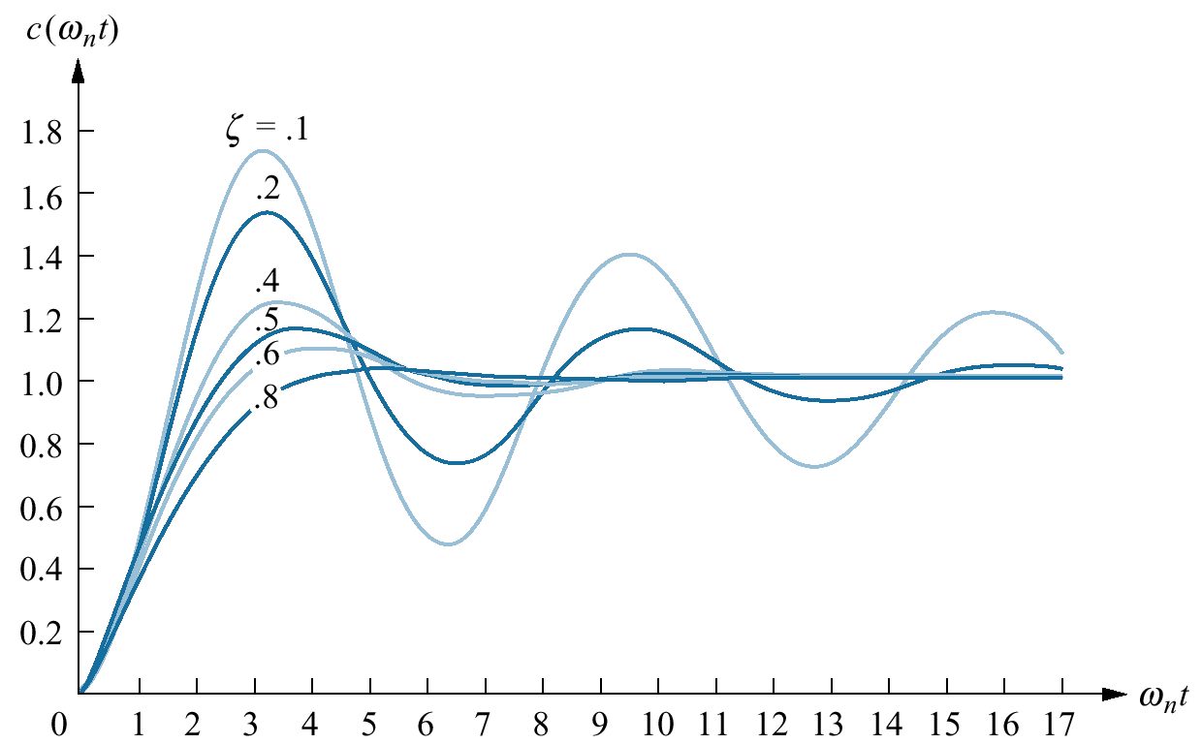
Figure 4.13
Second-order
underdamped
responses for
damping ratio
values

Slide 15
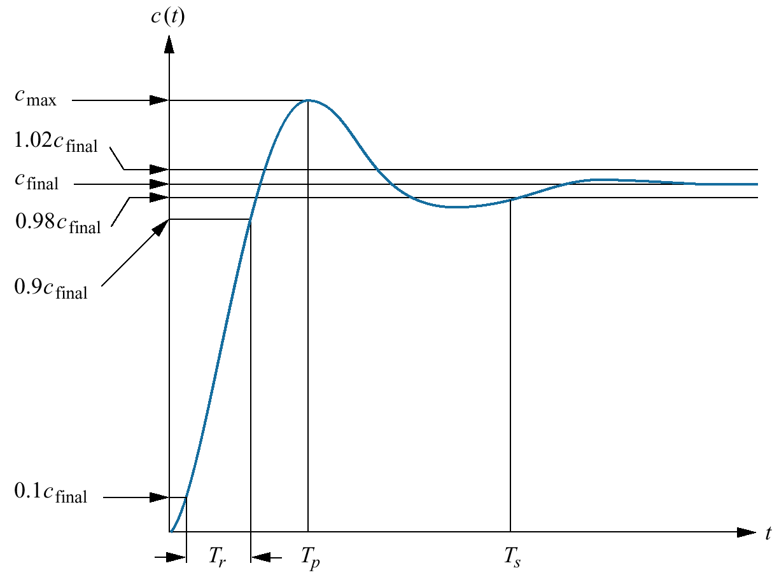
Figure 4.14
Second-order
underdamped
response
specifications

Slide 16
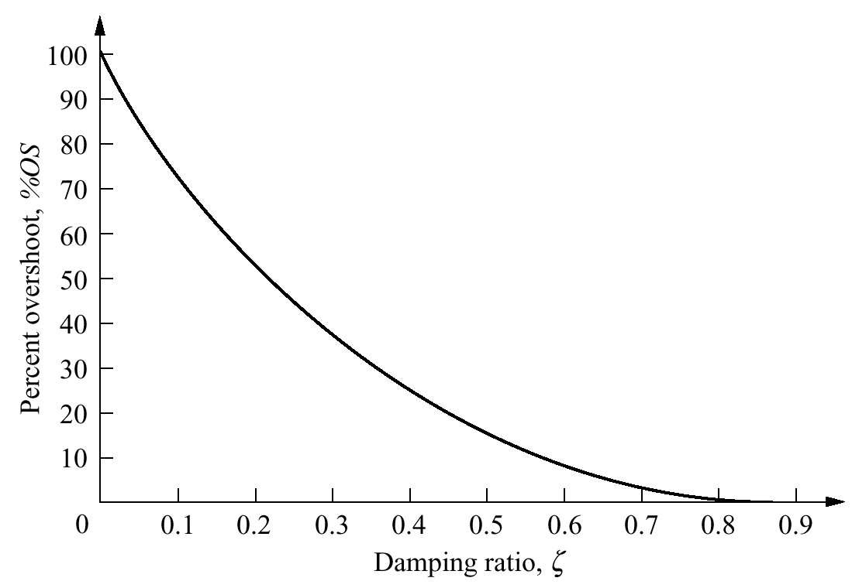
Figure 4.15
Percent
overshoot vs.
damping ratio

Slide 17
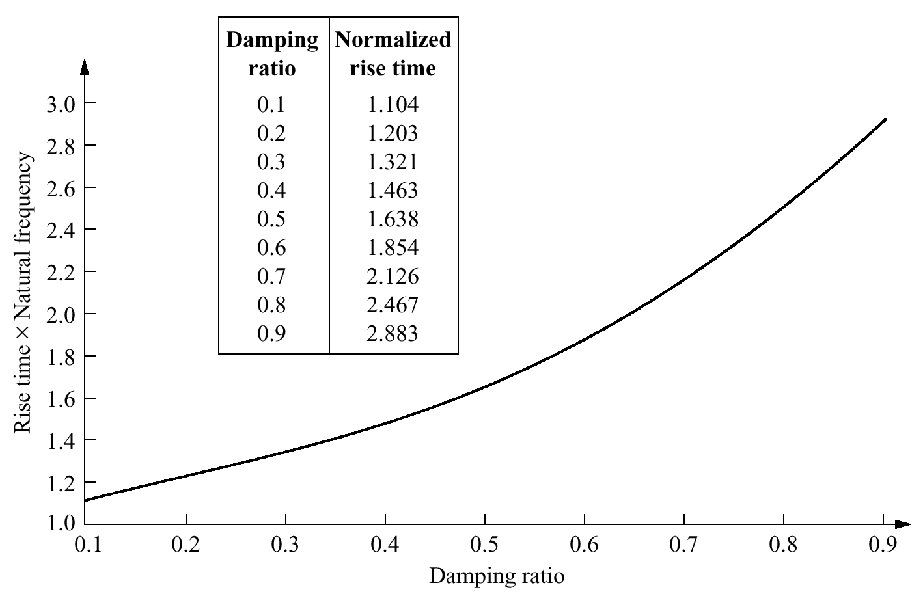
Figure 4.16
Normalized rise
time vs. damping
ratio for a
second-order
underdamped
response

Slide 18
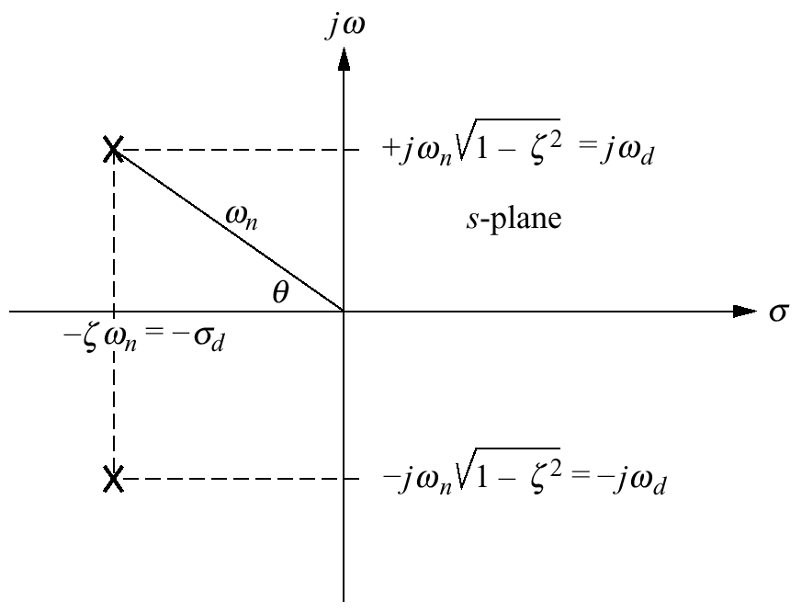
Figure 4.17
Pole plot for an
underdamped
second-order
system

Slide 19
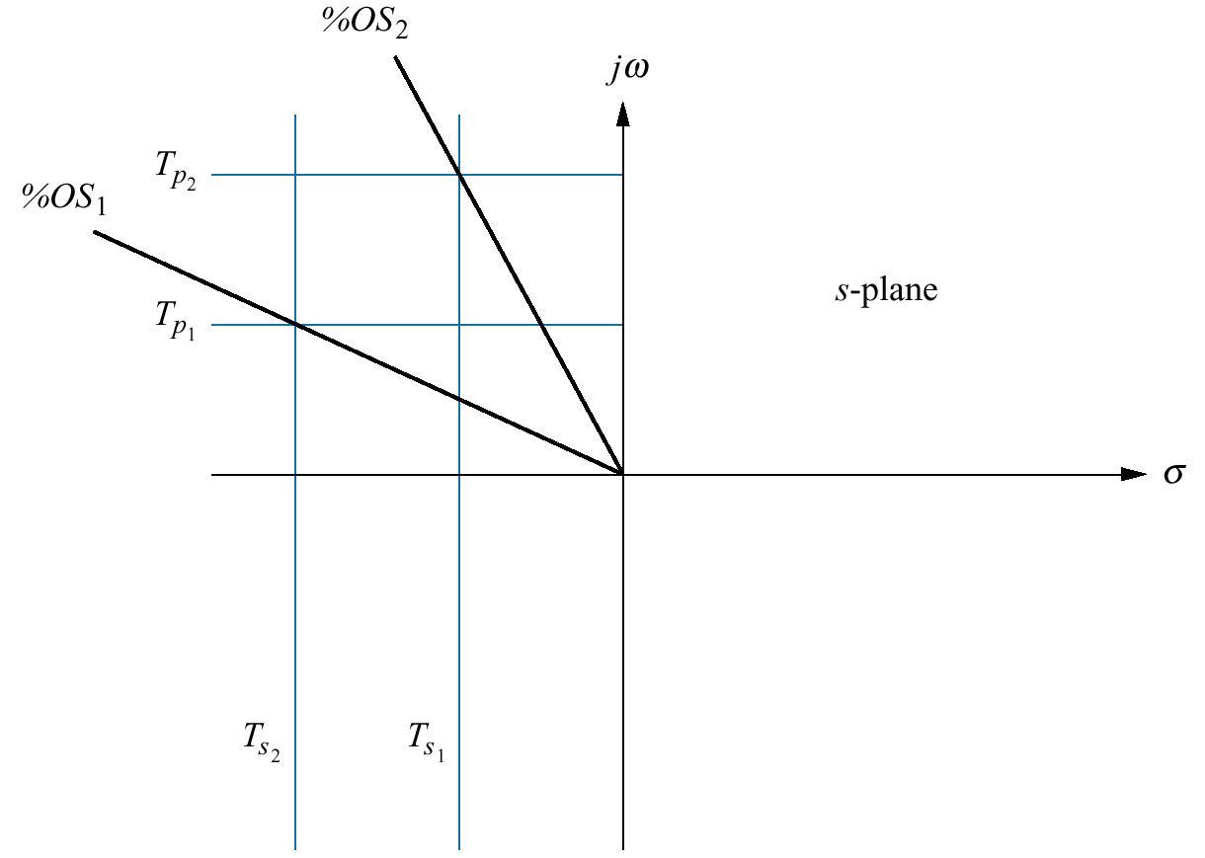
Figure 4.18
Lines of constant
peak time,T_{p} , settling
time,T_{s} , and percent
overshoot, %OS
Note: T_{s2} < T_{s1} ;
T_{p2} < T_{p1}; %OS₁ <
%OS₂

Slide 20
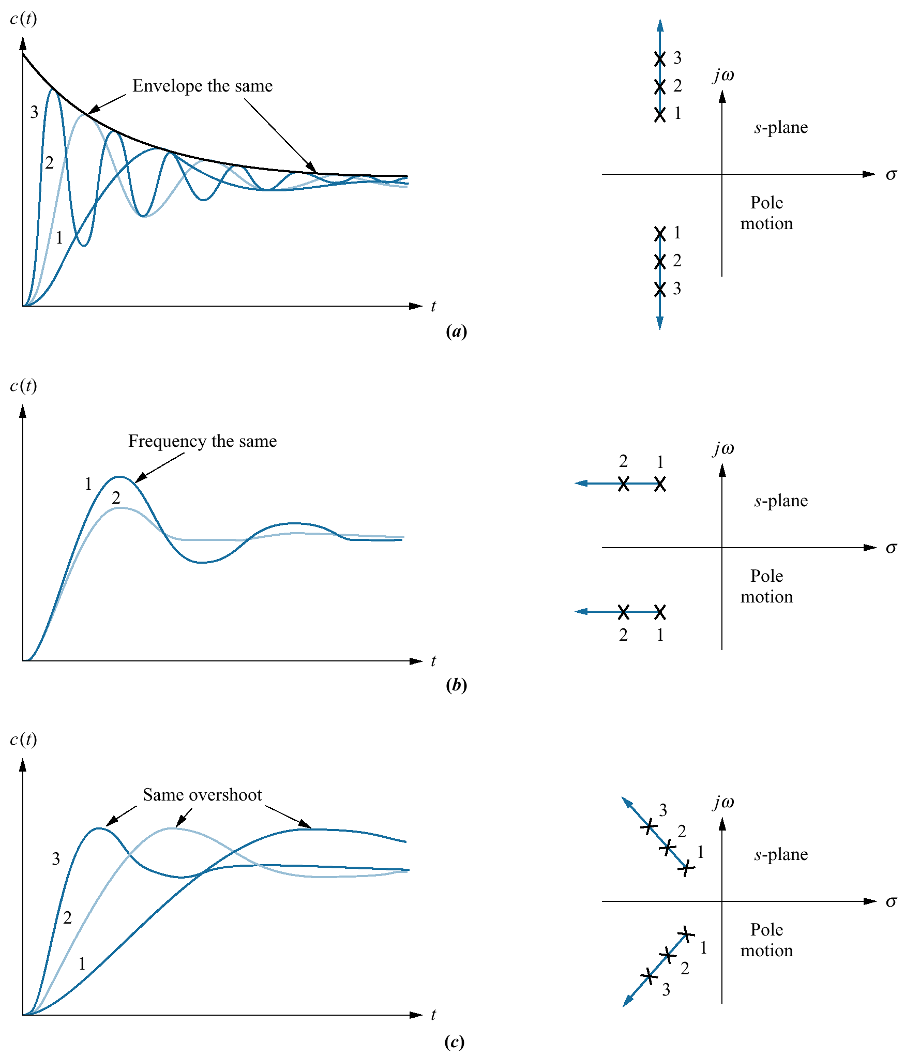
Figure 4.19
Step responses
of second-order
underdamped
systems
as poles move:
a. with constant
real part;
b. with constant
imaginary part;
c. with constant
damping ratio

Slide 21
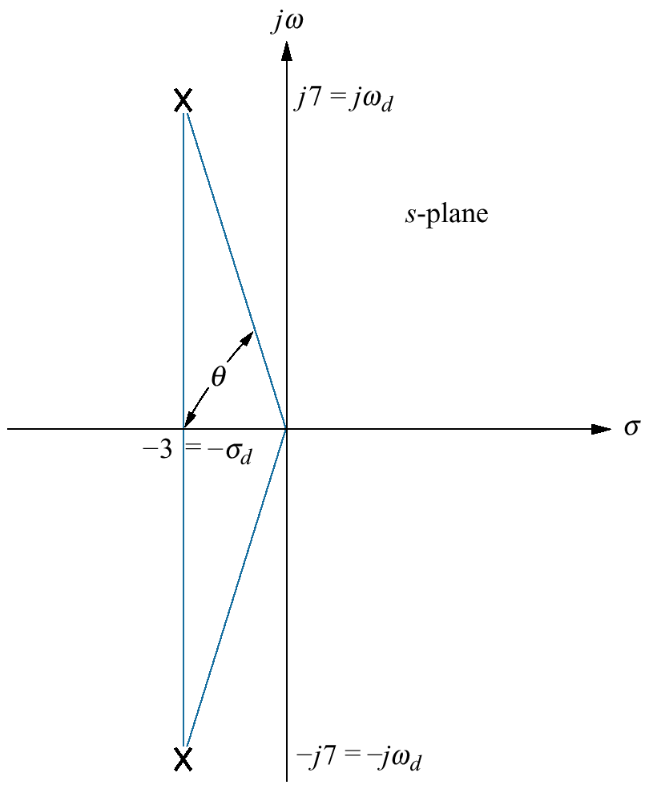
Figure 4.20
Pole plot for
Example 4.6

Slide 22
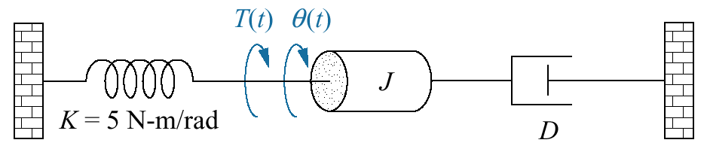
Figure 4.21
Rotational
mechanical system
for Example 4.7

Slide 23
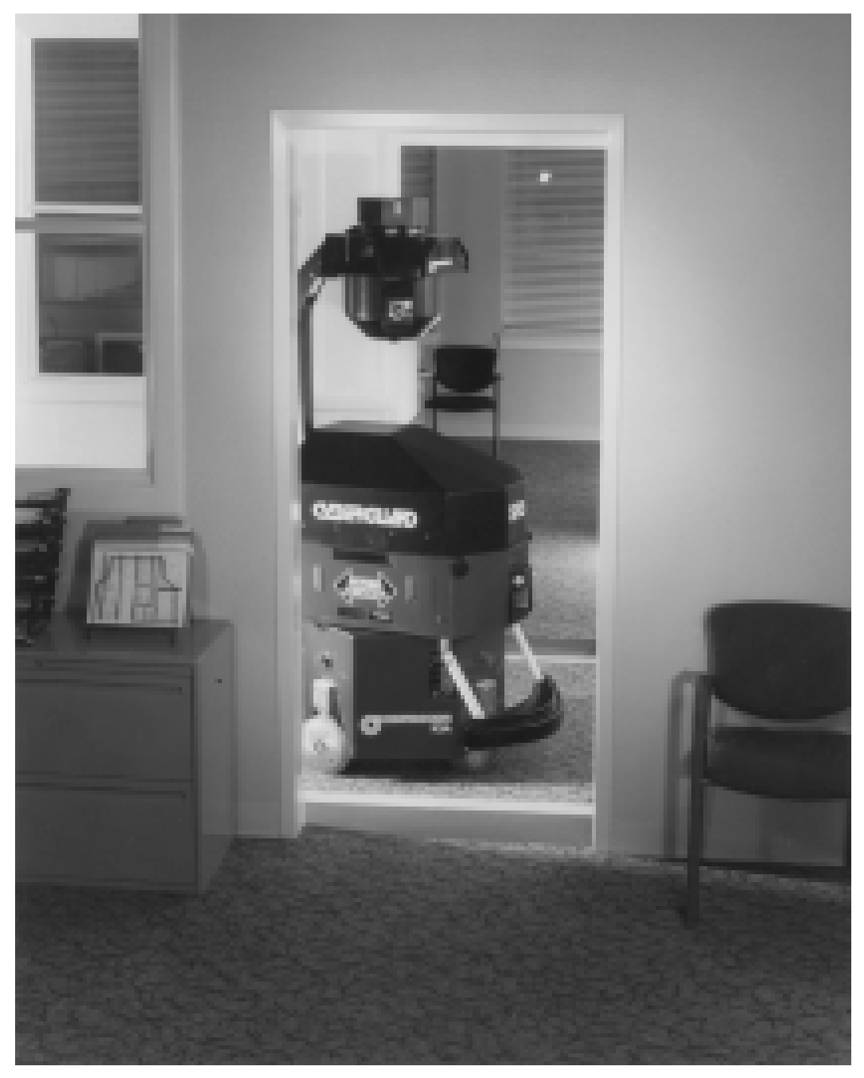
Figure 4.22
The Cybermotion
SR3 security robot
on patrol. The
robot navigates by
ultrasound and path
programs transmitted
from a computer,
eliminating the need
for guide strips on
the floor. It has video
capabilities as well as
temperature, humidity,
fire, intrusion, and gas
sensors.

Slide 24
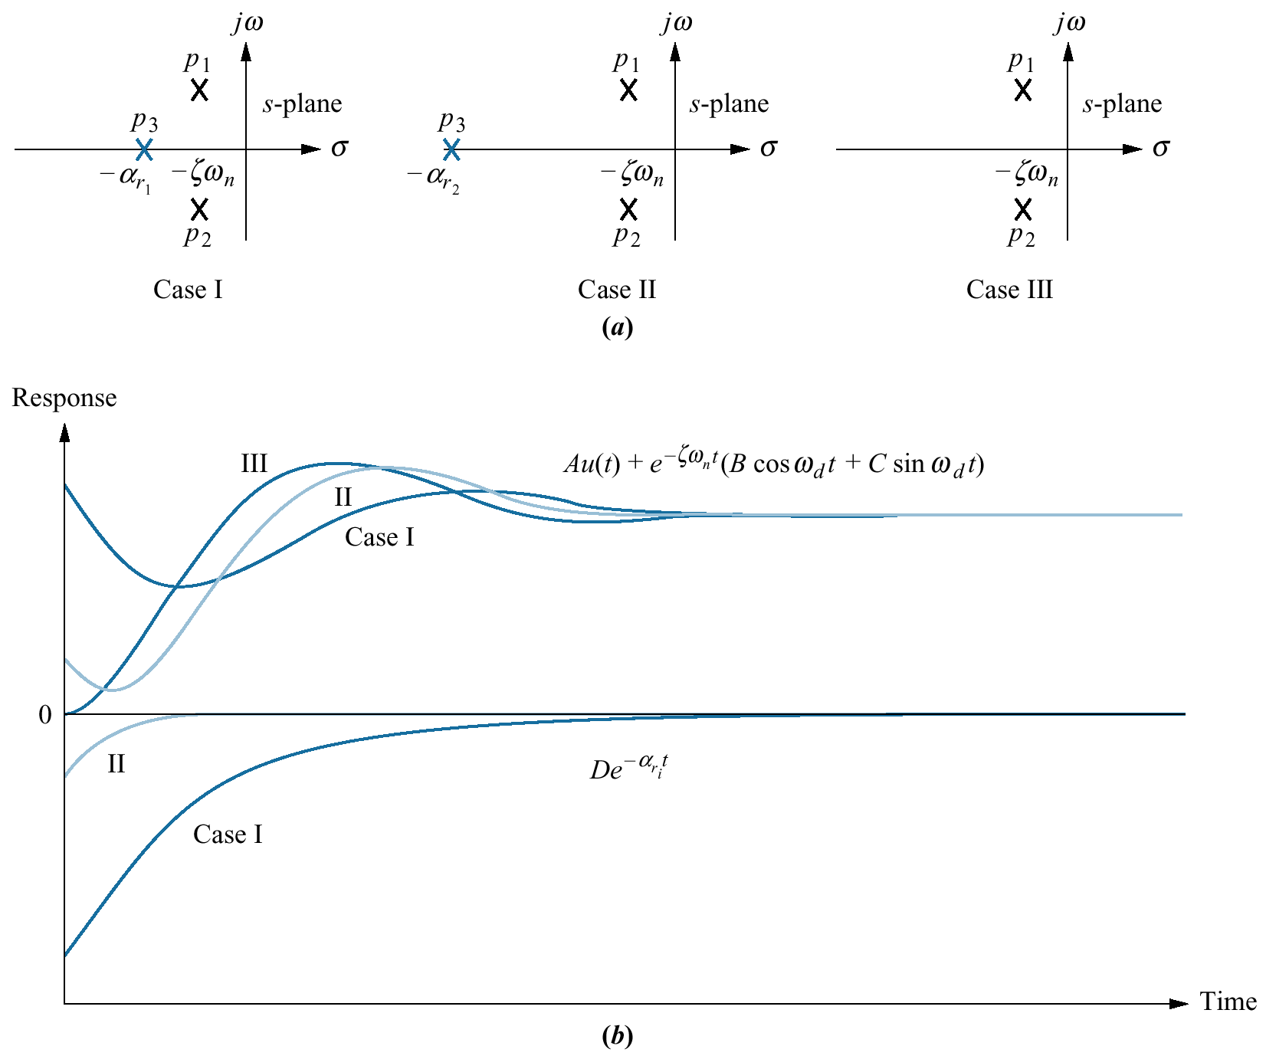
Figure 4.23
Component responses
of a three-pole
system:
a. pole plot;
b. component
responses: nondom-
inant pole is near
dominant second-order
pair (Case I), far from
the pair (Case II), and
at infinity (Case III)

Slide 25
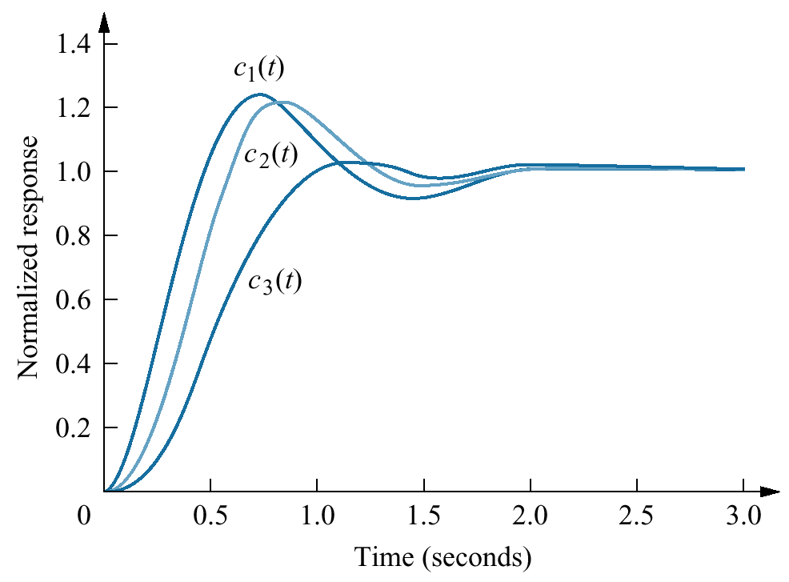
Figure 4.24
Step responses
of system T₁(s),
system T₂(s), and
system T₃(s)

Slide 26
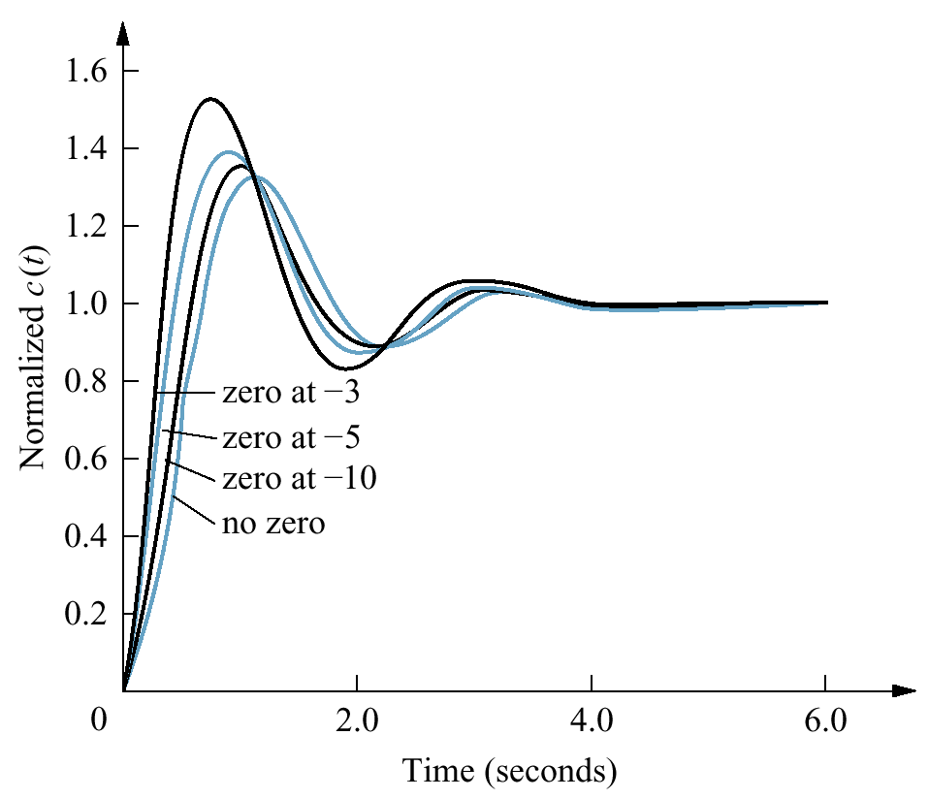
Figure 4.25
Effect of adding
a zero to a
two-pole system

Slide 27
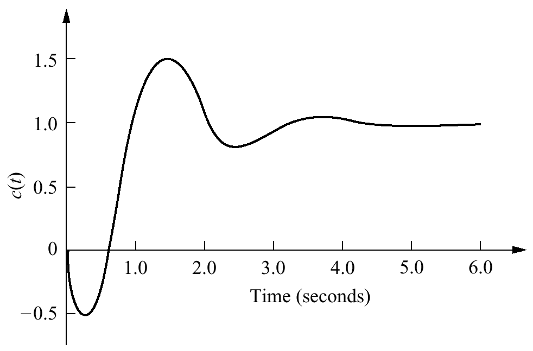
Figure 4.26
Step response of a
nonminimum-phase
system

Slide 28
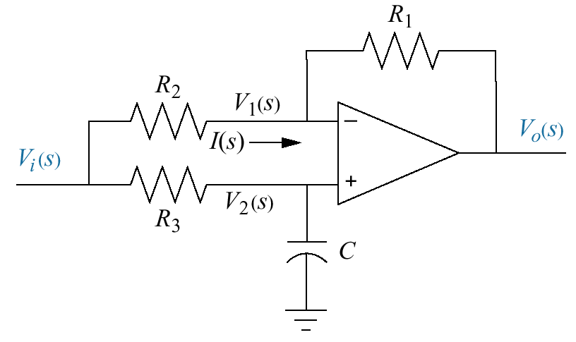
Figure 4.27
Nonminimum-phase
electrical circuit

Slide 29
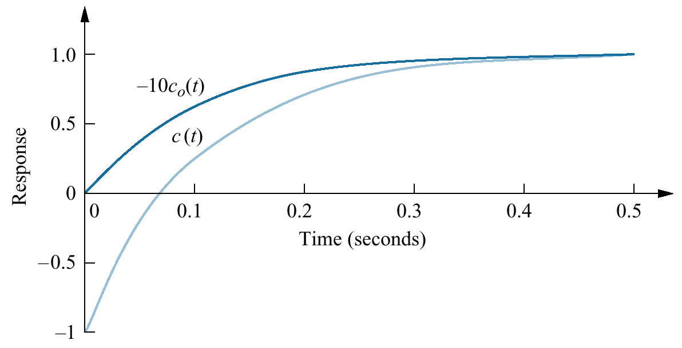
Figure 4.28
Step response of the
nonminimum-phase
network of Figure 4.27
(c(t)) and normalized
step response of an
equivalent network
without the zero
(-10c_{o}(t))

Slide 30
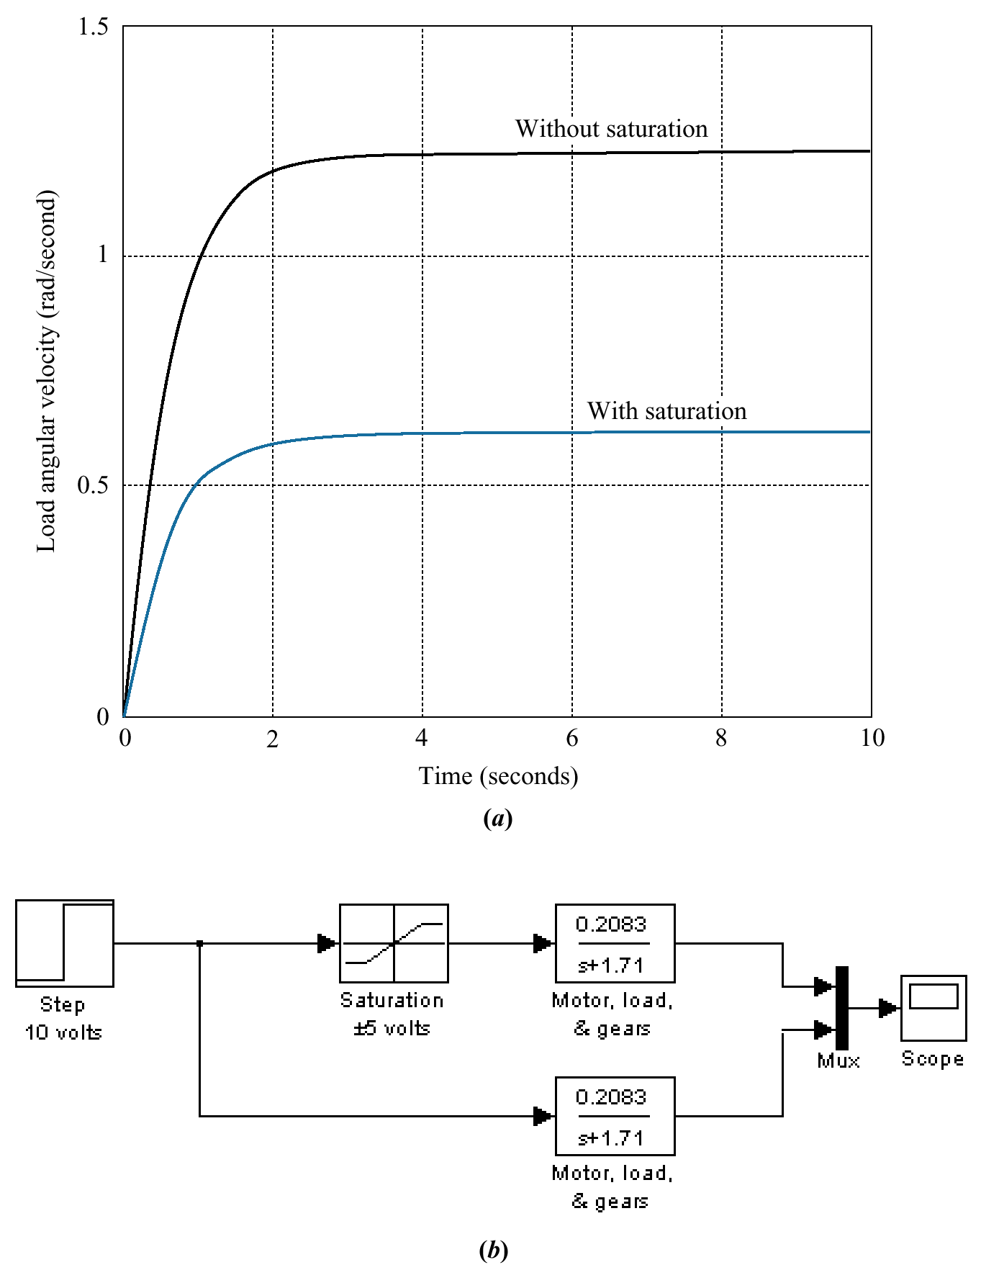
Figure 4.29
a. Effect of amplifier
saturation on load
angular velocity
response;
b. Simulink block
diagram

Slide 31
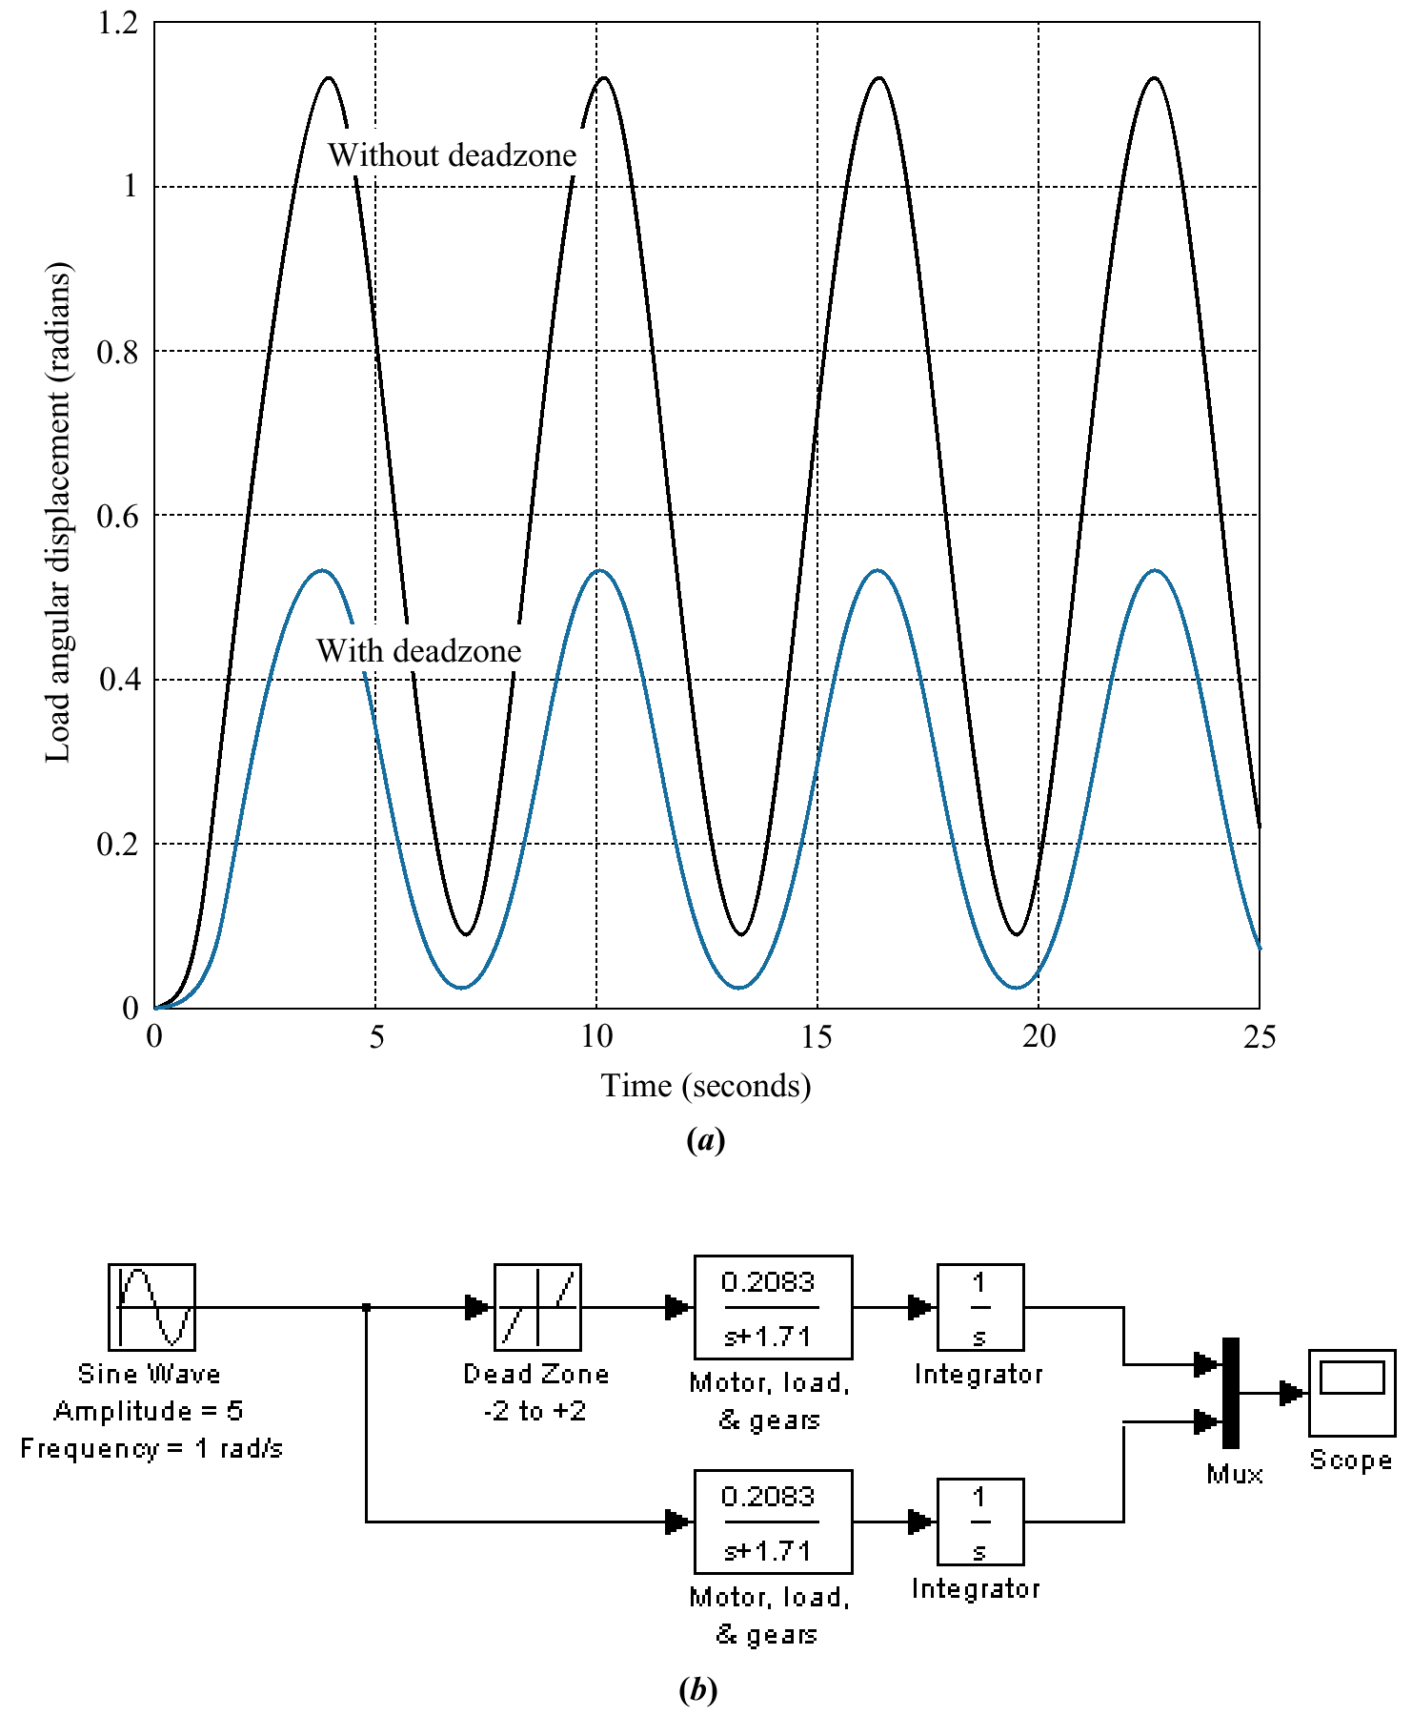
Figure 4.30
a. Effect of
deadzone on
load angular
displacement
response;
b. Simulink block
diagram

Slide 32
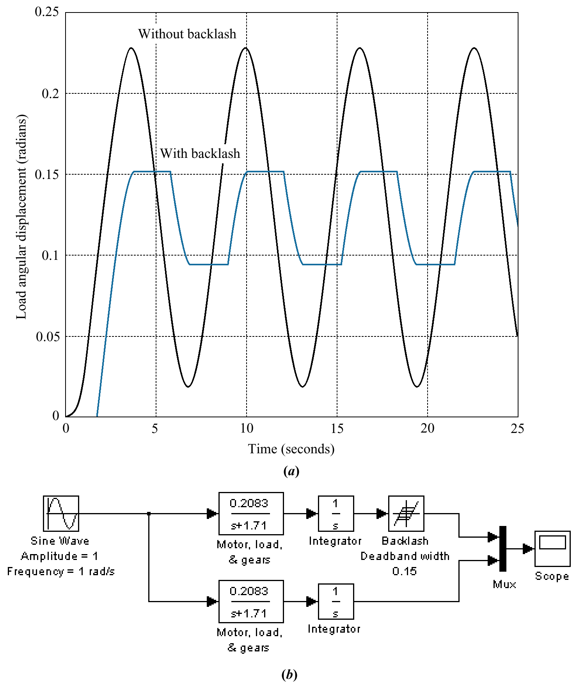
Figure 4.31
a. Effect of backlash
on load angular
displacement
response;
b. Simulink block
diagram

Slide 33
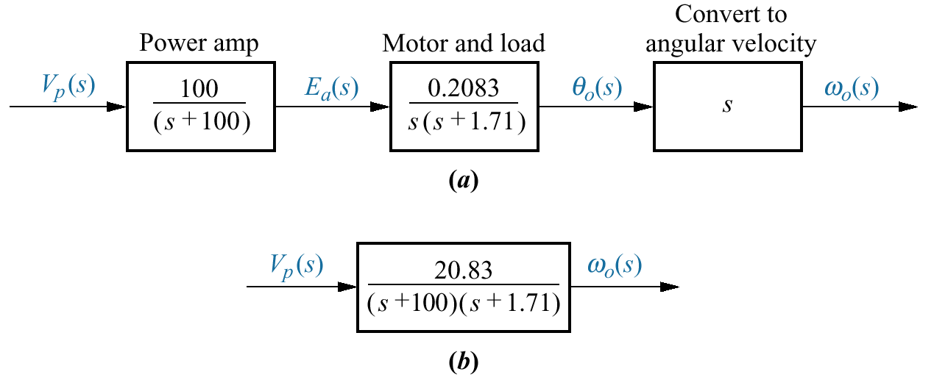
Figure 4.32
Antenna azimuth
position control
system for angular
velocity:
a. forward path;
b. equivalent
forward path

Slide 34
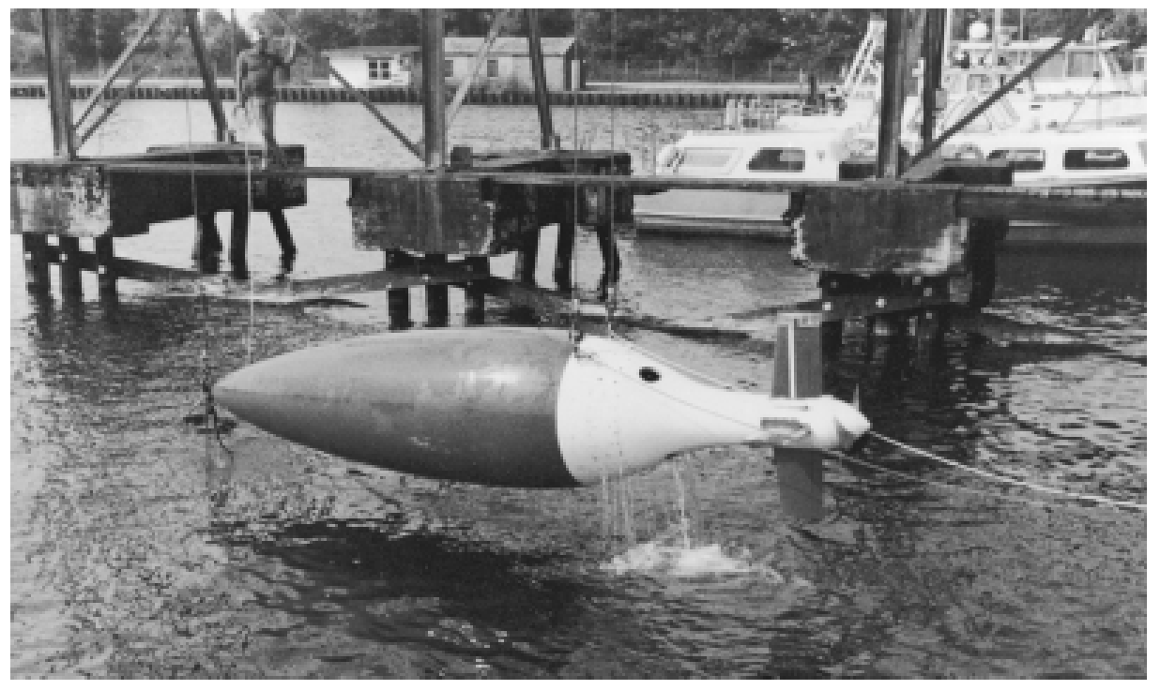
Figure 4.33
Unmanned
Free-Swimming
Submersible
(UFSS) vehicle

Slide 35
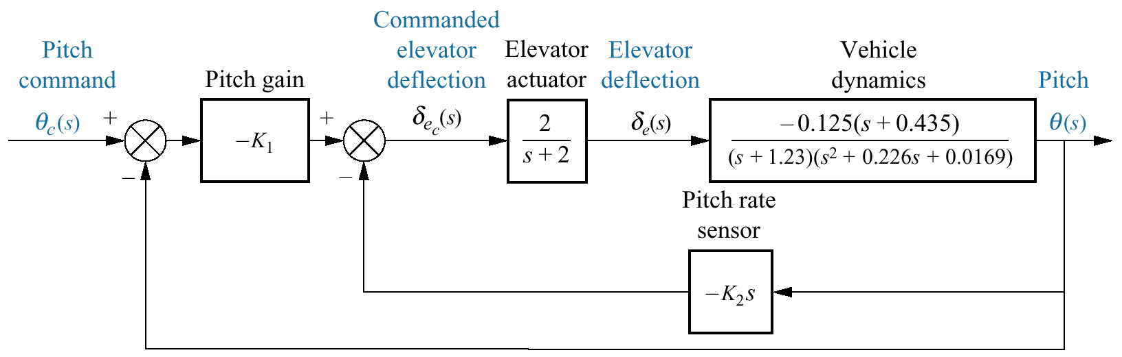
Figure 4.34
Pitch control loop for
the UFSS vehicle

Slide 36
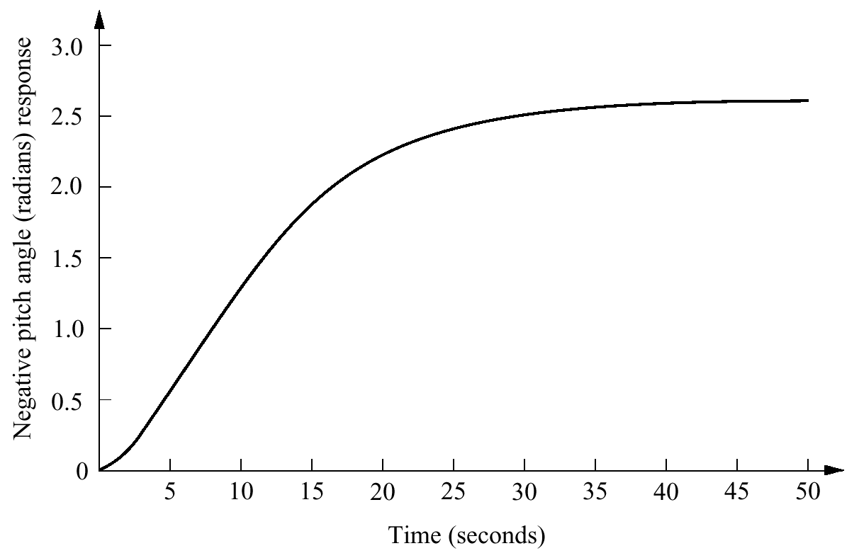
Figure 4.35
Negative step
response of pitch
control for UFSS
vehicle

Slide 37
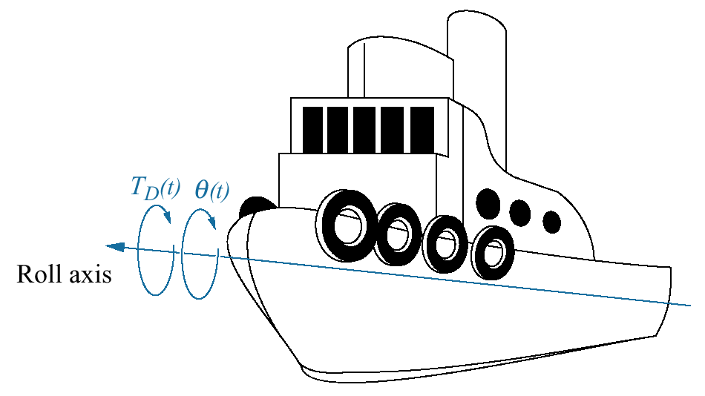
Figure 4.36
A ship at sea,
showing roll axis

Slide 38
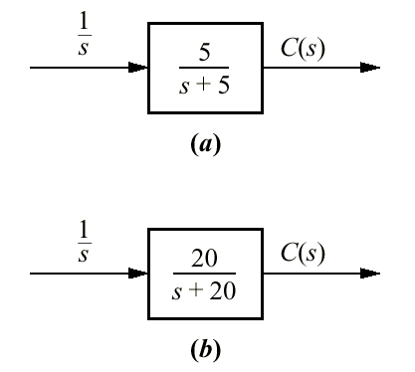
Figure P4.1

Slide 39
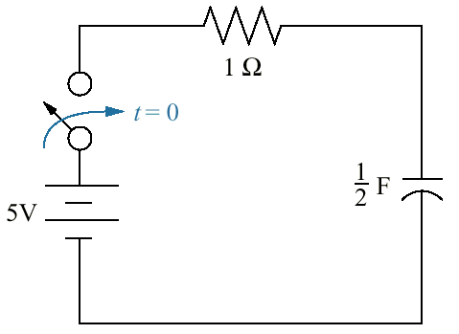
Figure P4.2

Slide 40
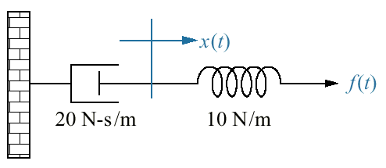
Figure P4.3

Slide 41
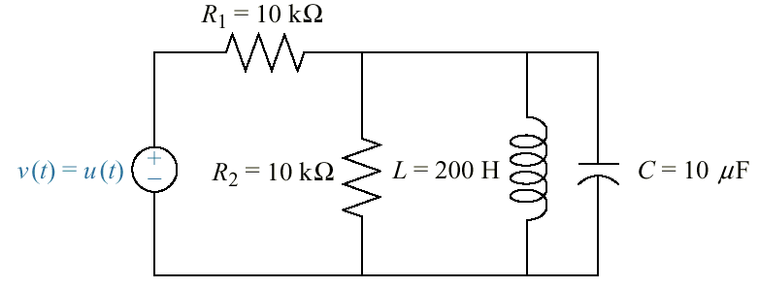
Figure P4.4

Slide 42
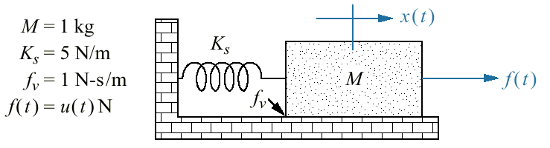
Figure P4.5

Slide 43
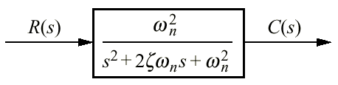
Figure P4.6

Slide 44
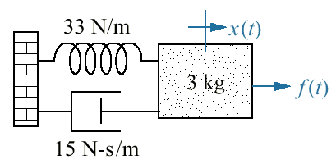
Figure P4.7

Slide 45
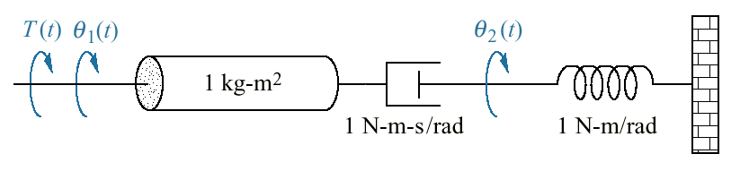
Figure P4.8

Slide 46
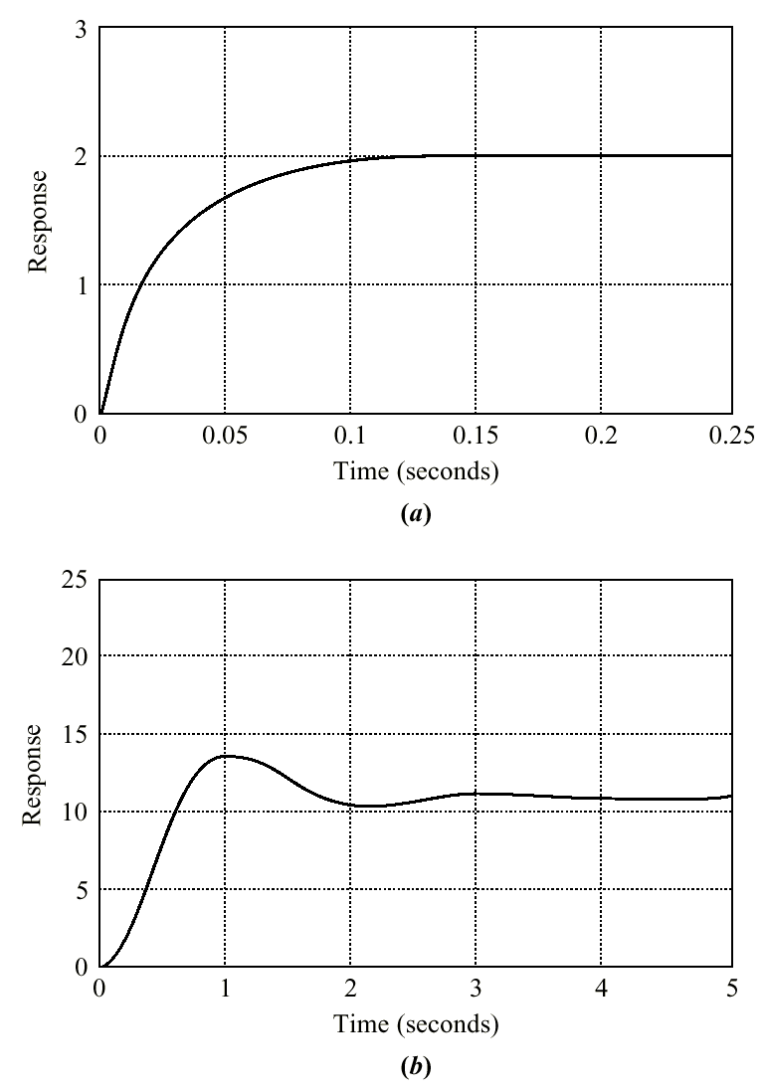
Figure P4.9
(figure continues)

Slide 47
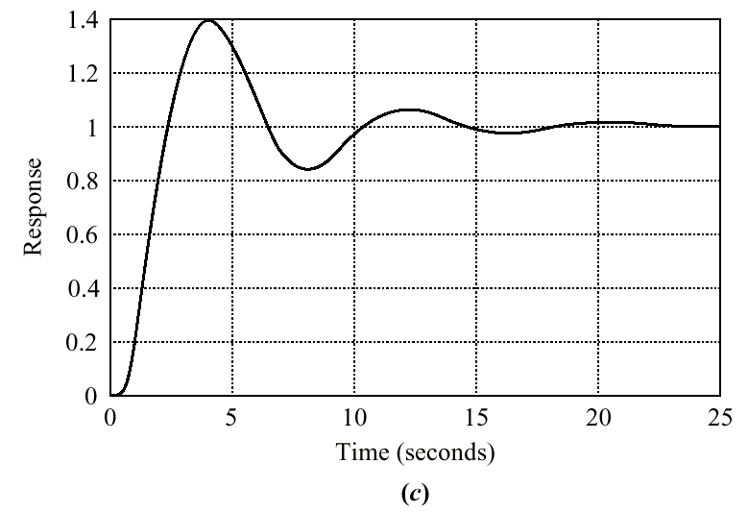
Figure P4.9
(continued)

Slide 48
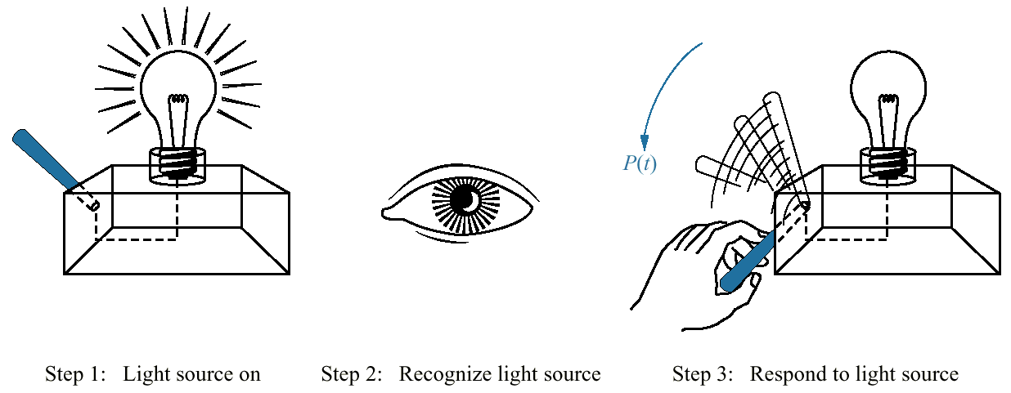
Figure P4.10
Steps in determining
the transfer function
relating output physical
response to the input
visual command

Slide 49
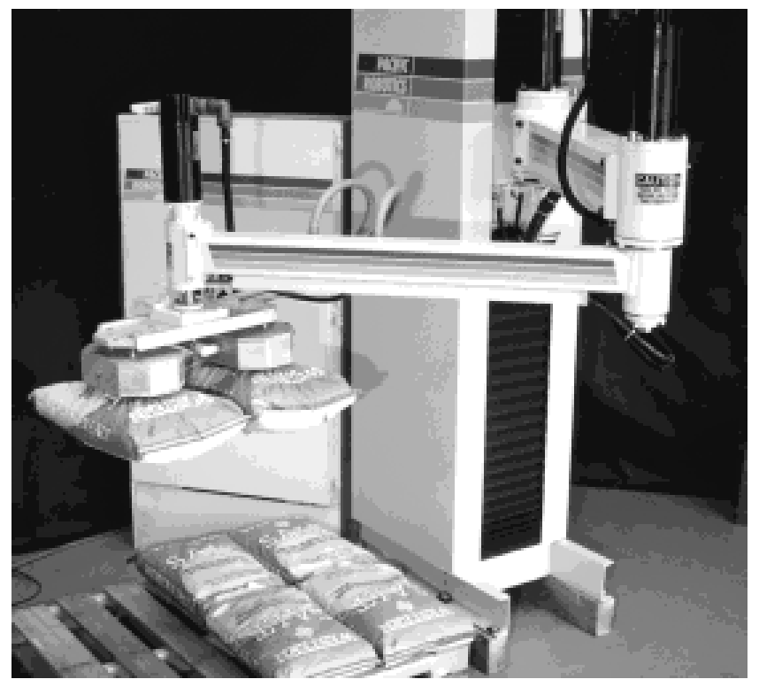
Figure P4.11
Vacuum robot lifts
two bags of salt

Slide 50
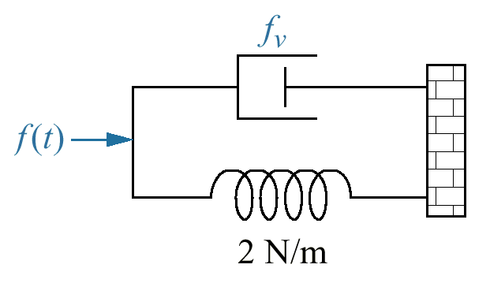
Figure P4.12

Slide 51
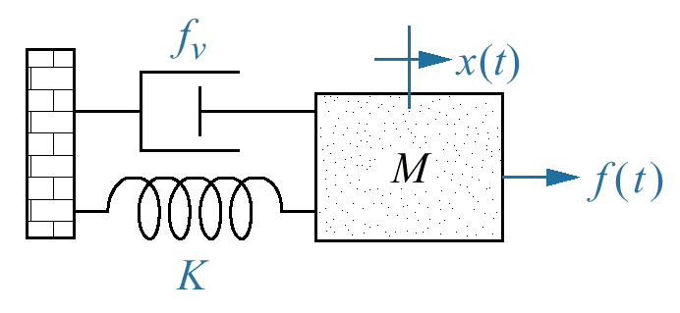
Figure P4.13

Slide 52

Figure P4.14

Slide 53

Figure P4.15

Slide 54

Figure P4.16

Slide 55

Figure P4.17

Slide 56

Figure P4.18

Slide 57

Figure P4.19

Slide 58

Figure P4.20
Pump diagram

